Slide 1

OS Lab 5

Slide 2
Inter process communication (IPC)
Inter process communication (IPC) is a mechanism which allows processes to communicate each other and synchronize their actions.
The communication between these processes can be seen as a method of co-operation between them.
Processes can communicate with each other using these two ways:
Shared Memory
Message passing

Slide 3
pipe() System call
a pipe is a connection between two processes, such that the standard output from one process becomes the standard input of the other process.
In UNIX Operating System, Pipes are useful for communication between related processes(inter-process communication).

Slide 4
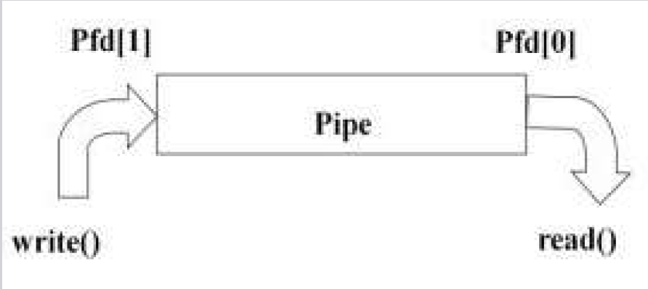

Slide 5
It is not very useful for a single process to use a pipe to talk to itself.
In typical use, a process creates a pipe just before it forks one or more child processes.
The pipe is then used for communication either between the parent or child processes, or between two sibling processes.

Slide 6
System Calls
Read ()
Write()
Close()
Pipe()
Dup(), Dup2()

Slide 7
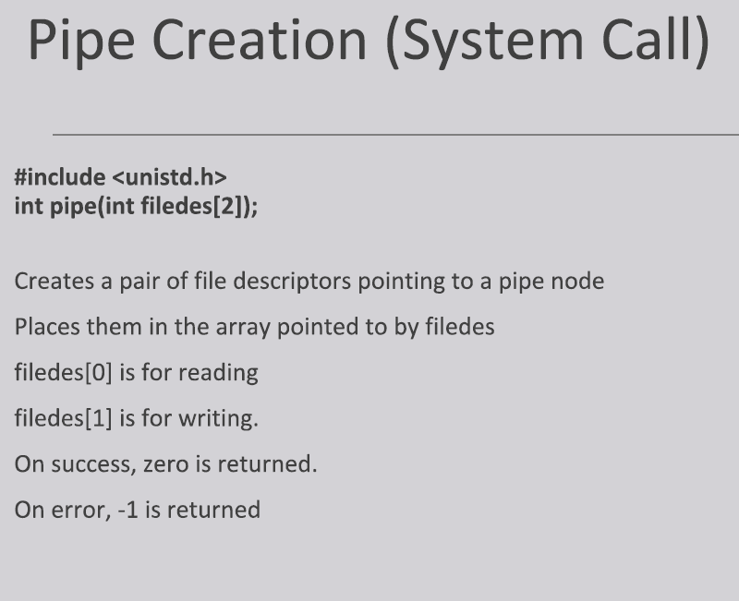

Slide 8
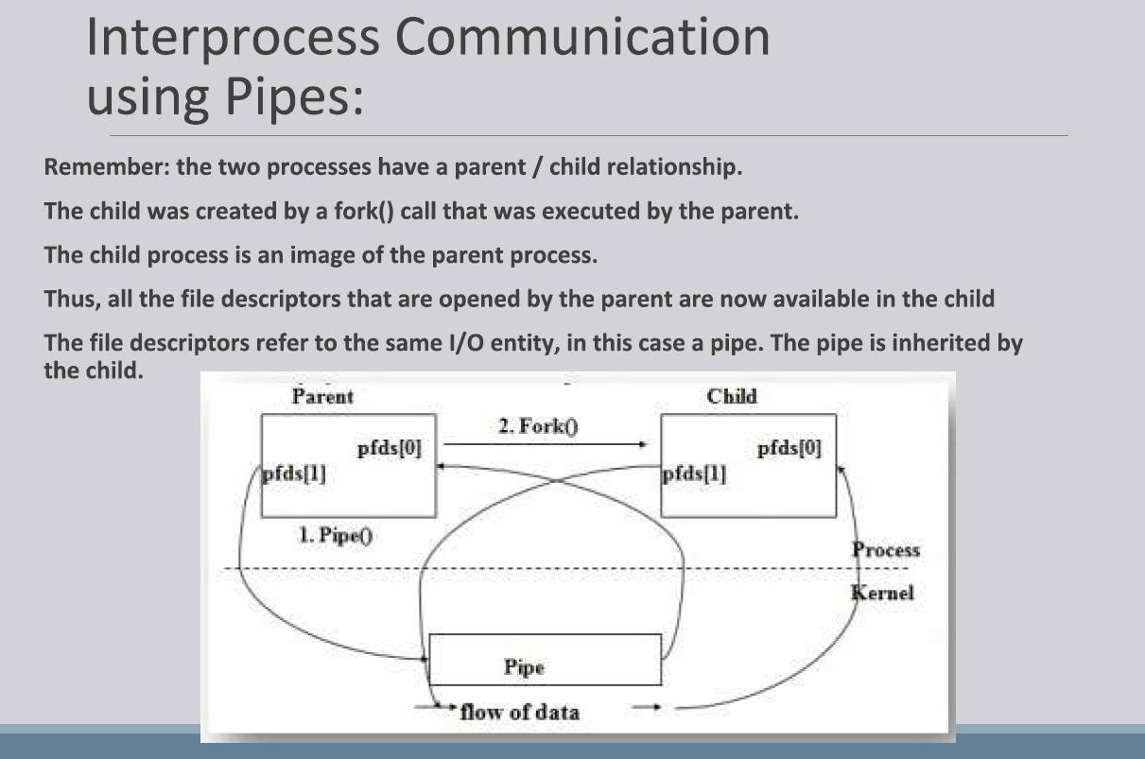

Slide 9
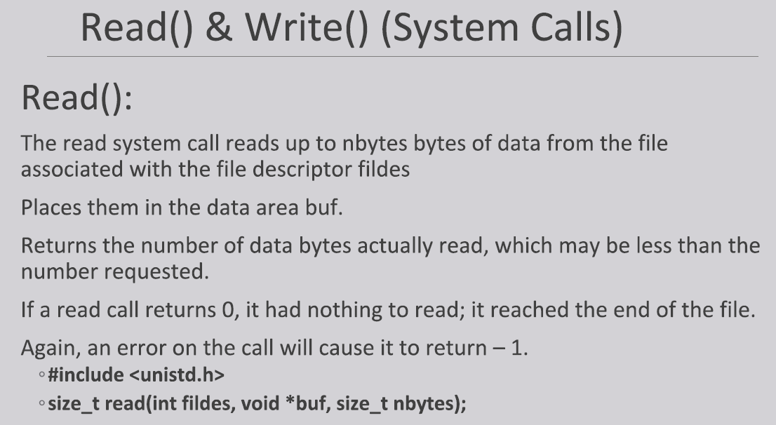

Slide 10
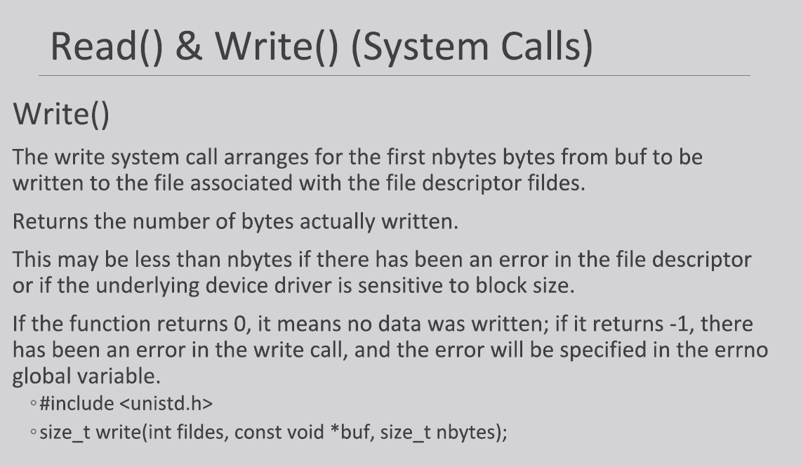

Slide 11


Slide 12
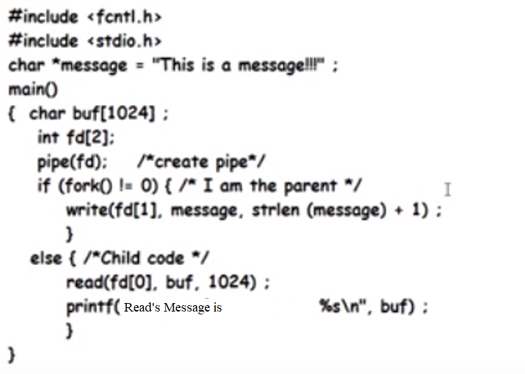
Example:- Pipe concept …!
Parent writes into pipe and child reads from pipe

